Slide 1

Project 3
Erin, Mahyar, Haya, Patrick

Slide 2
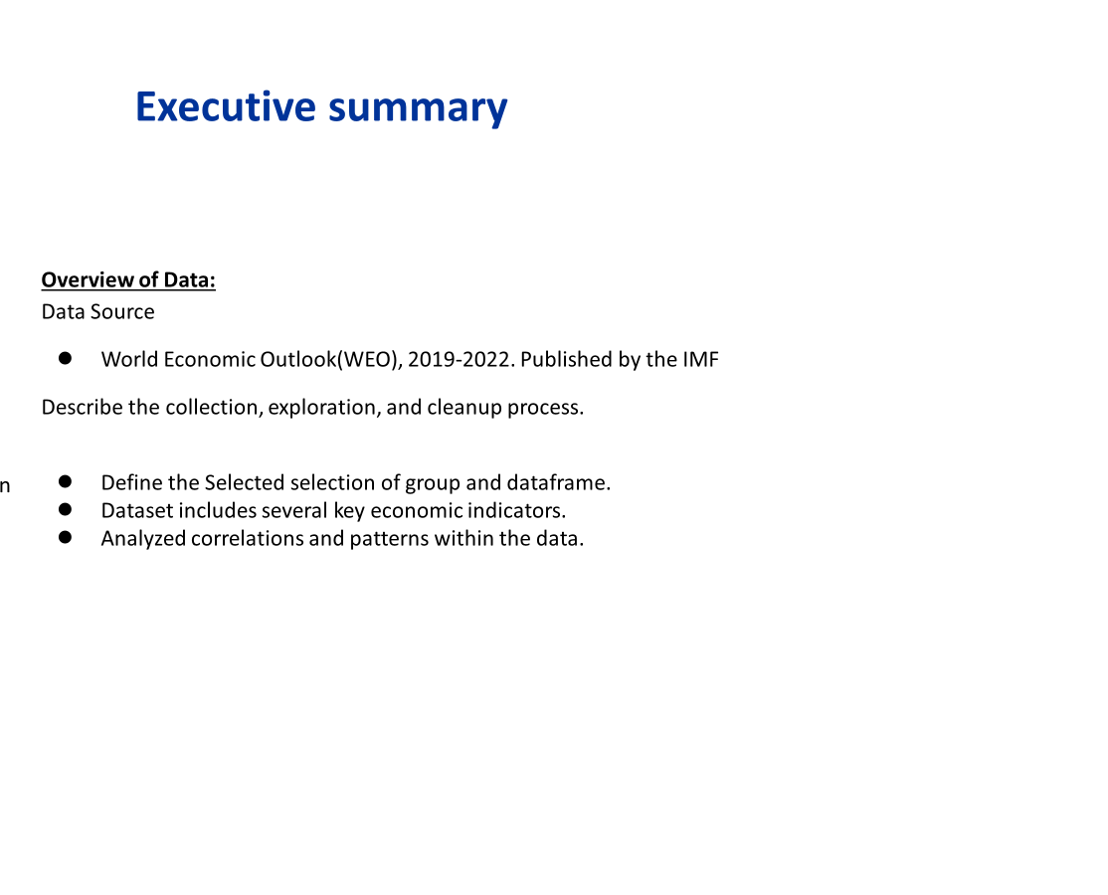
Comparative analysis of regions and economic indicators

Slide 3
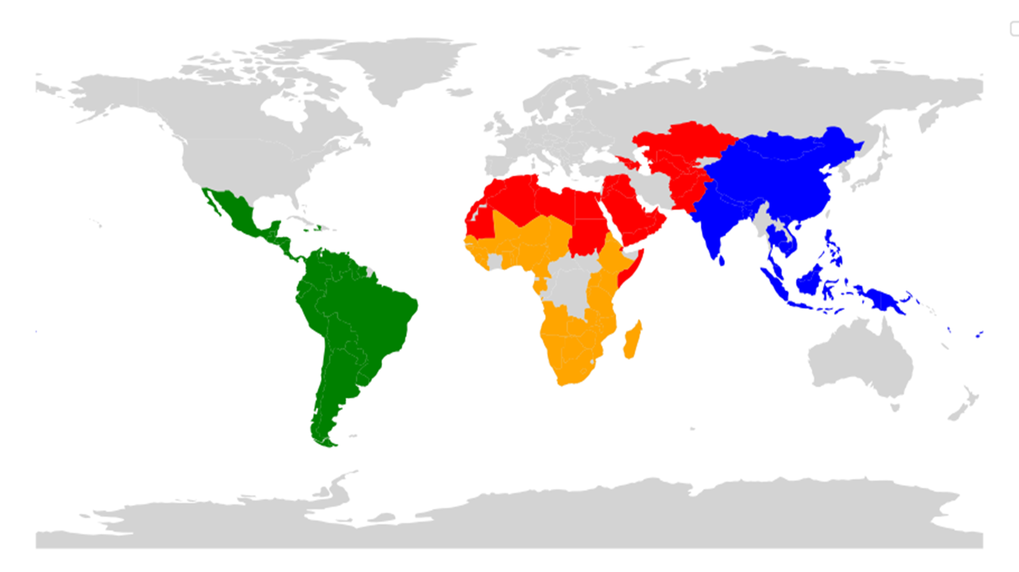

Slide 4
Process Notes
Process data in SQL and converted to CSV
Merged coordinates.csv with country data
Used pyMongo and Pandas to filter data for use in visualizations
Used Javascript, html, dash, Leaflet, and Plotly to generate visualizations

Slide 5
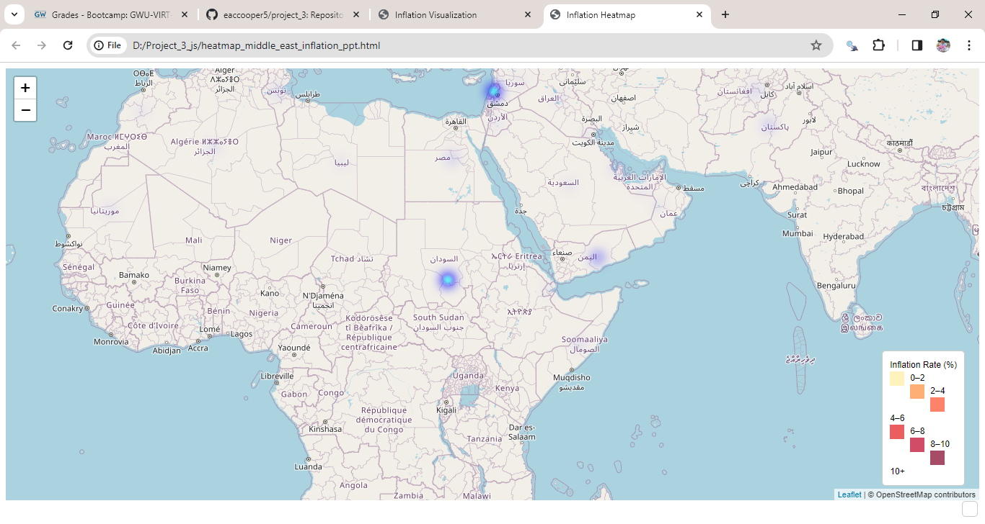

Slide 6
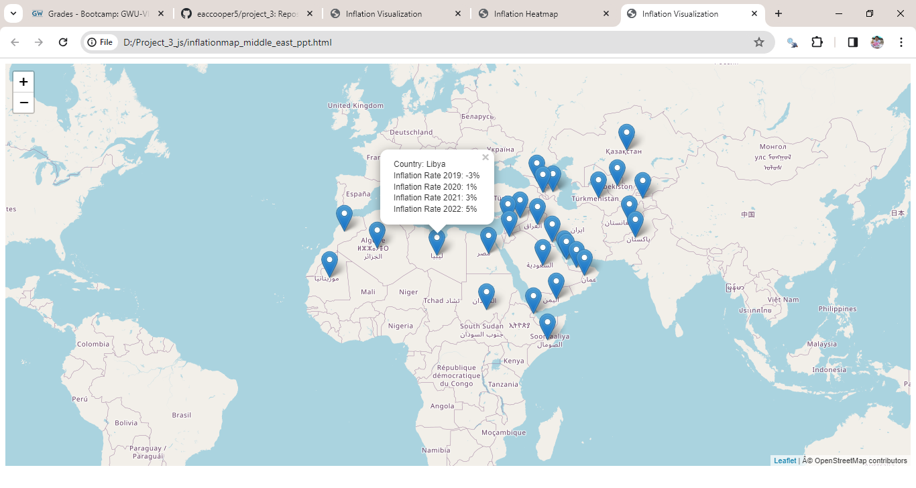

Slide 7
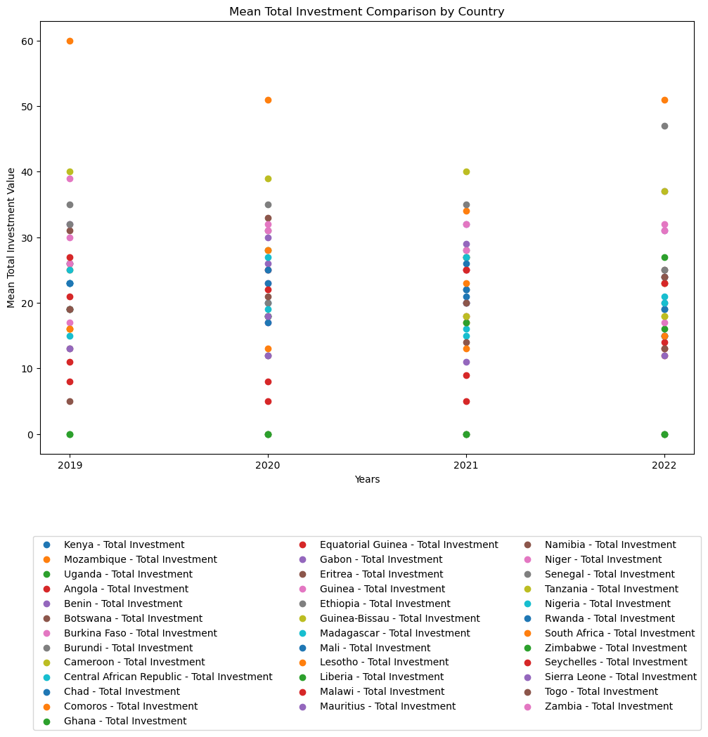
Mean Total Investment By Country: Africa
Notes:
Investments went up in 2020, dropped in 2021 and raised again in 2022.

Slide 8
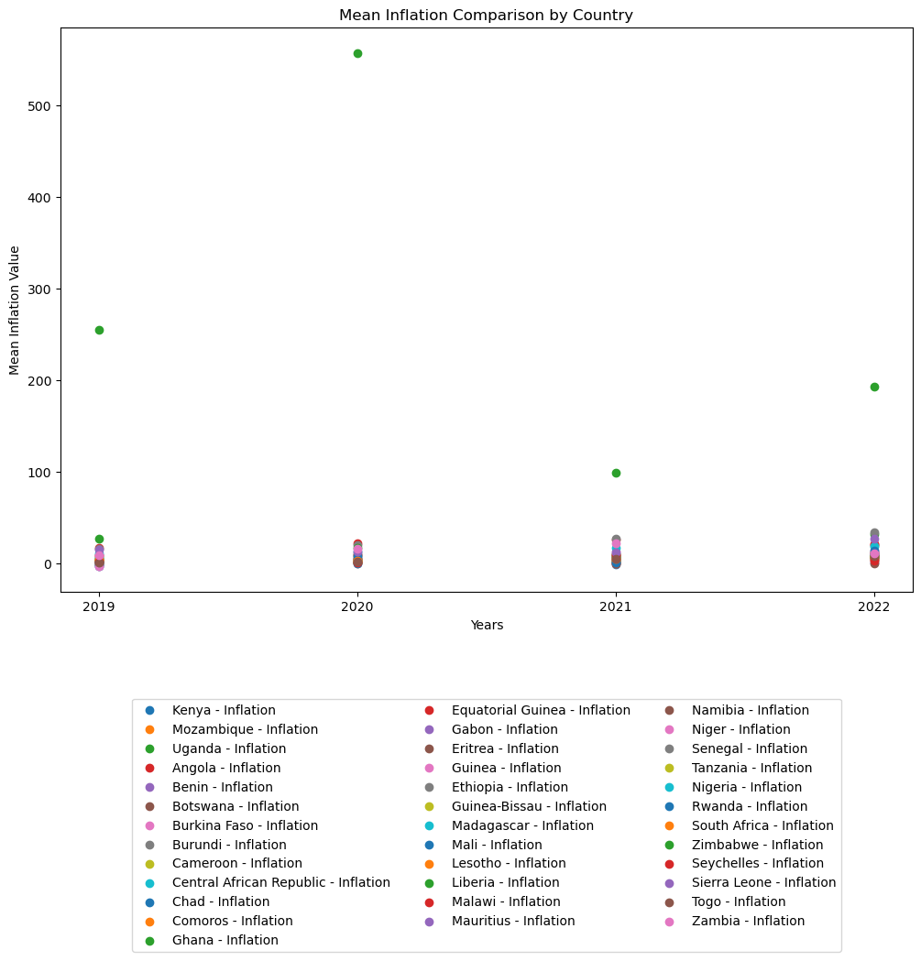
Inflation: Emerging Africa
Notes:
Inflation: Went up in 2020, dropped again and raised again in 2022. Changes in growth, government policies, and interest in natural resources (such as oil) brought fluctuations in both inflation and investments.

Slide 9
Project Challenges
- Incorporating geoJSON into Leaflet with or without creating a server
- Size of the dataset and number of countries involved
- Number of indicators and lack of reporting for some indicators
- File organization
- Life stuff

Slide 10


